Slide 1
Group 1
PROJECT PROPOSAL
106-1 10/26 Software Engineering Design

Slide 2
Requirement 1 (Shopping Site)
Homework
WBS
Estimation Model
Open source work-through

Slide 3
Homework
WBS
Estimation Model
Open source work-through
Requirement 2 (Sales Report)

Slide 4
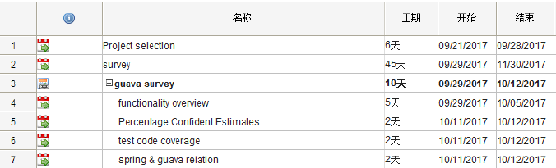
WBS
Homework
WBS
Estimation Model
Open source work-through

Slide 5
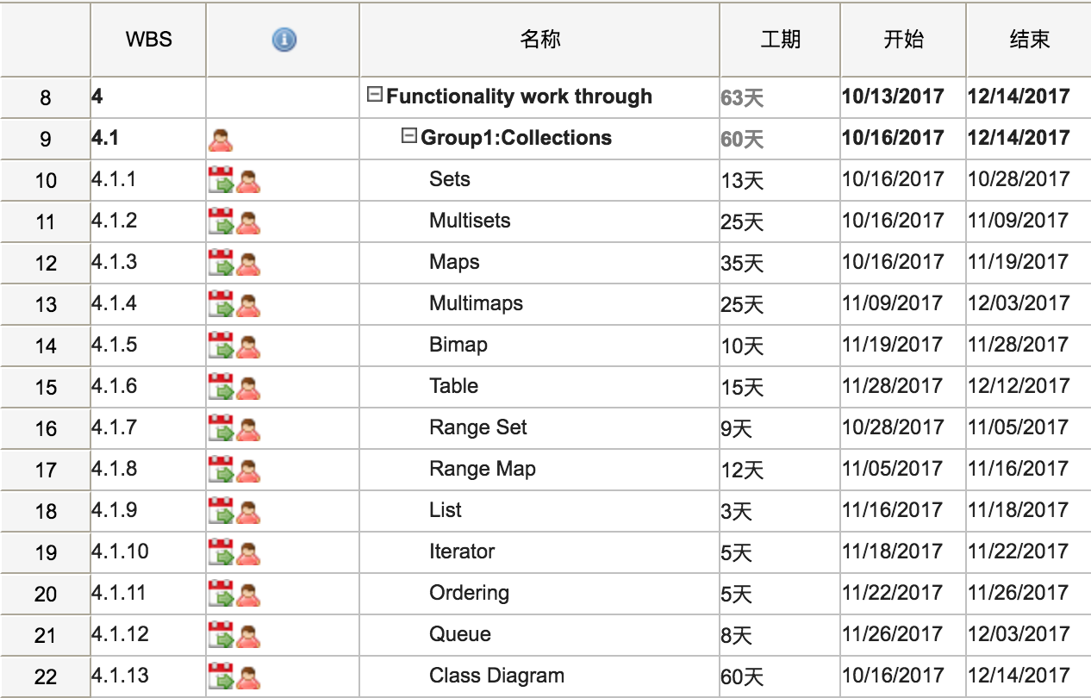
WBS
Homework
WBS
Estimation Model
Open source work-through

Slide 6
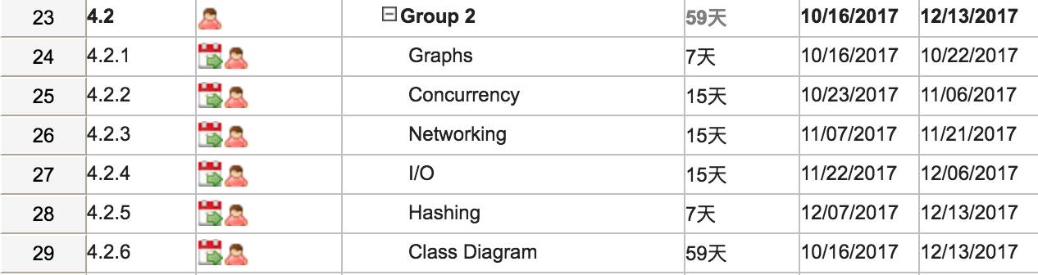
WBS
Homework
WBS
Estimation Model
Open source work-through

Slide 7
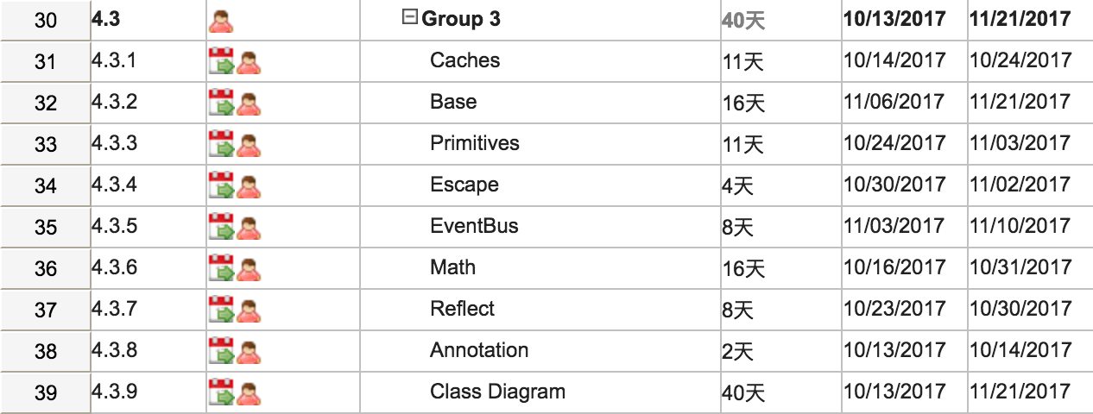
WBS
Homework
WBS
Estimation Model
Open source work-through

Slide 8
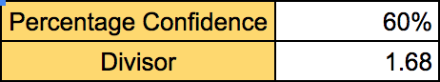
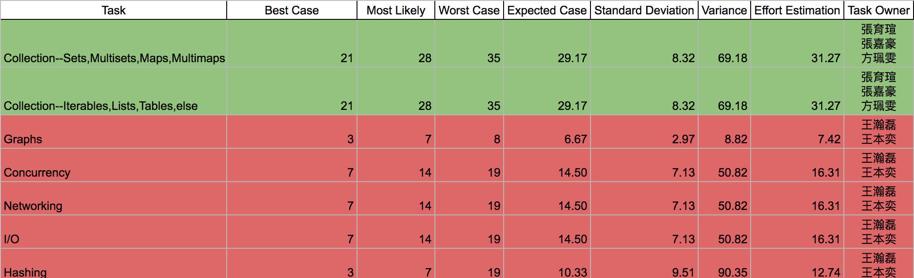
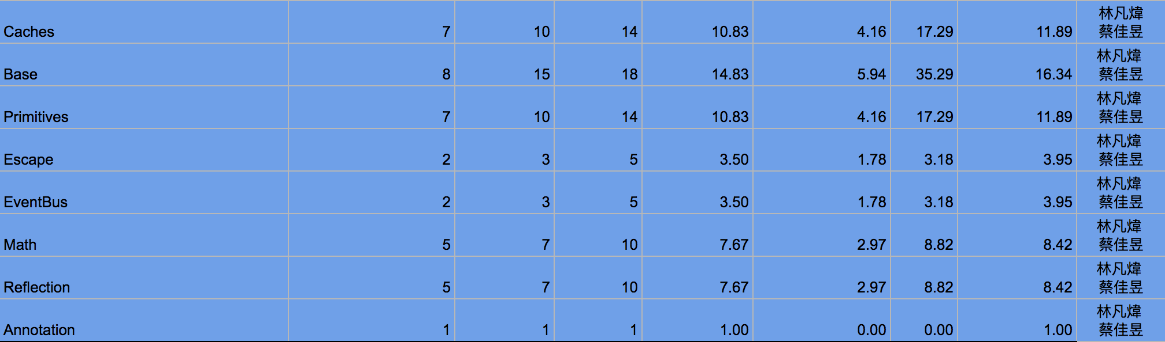
Estimation Model
Homework
WBS
Estimation Model
Open source work-through

Slide 9
Open source work-through
Homework
WBS
Estimation Model
Open source work-through
Graph: class diagram

Slide 10
Open source work-through
Homework
WBS
Estimation Model
Open source work-through
Graph: class diagram

Slide 11
Open source work-through
Homework
WBS
Estimation Model
Open source work-through
Graph: class diagram

Slide 12
Open source work-through
Homework
WBS
Estimation Model
Open source work-through
Cache: class diagram

Slide 13
Thanks!
Any questions?

